Slide 1
Student E-Placement Web Application Using Cloud
Guide,
K . Suresh,
Associate Professor.
By,
G.A.Venkateshwaran(921315104229),
_{J.Suresh(921314104205),}
_{J.Surya(921315104209),}
_{V.Sri Rahul(921315104198).}

Slide 2
ABSTRACT:-
The E- PLACEMENT is a web based application for the placement department of the college in order to provide the details of its students in a database for the companies to their process of recruitment provided with a proper login. This system can used for college to manage the student information with regards to placement details .This project contains all the details of the students that can be viewed by all the companies, but can be modified only by the student with an authorized service. Each and every detail will be controlled and coordinated by the placement coordinator. E-placement application can improve the campus recruitments easily.

Slide 3
AIM:
E- PLACEMENT is a total management and informative system, which provides the up-to date information of all the students in a particular college.
PROBLEM DEFINITION:-
Now a day’s campus placements are conducted in all colleges. Various software and other sector companies are conducting campus selections for selecting merit candidates. When campus selections are conducted the students should provide their curriculum vitae to the concern officer for attending the campus interviews. This routine process is maintained manually, like maintenance of their resumes in papers. This can be automated by designing software.

Slide 4
EXISTING SYSTEM:-
The earlier system is not computerized. All transactions in the system are done manually maintaining records. To make this laborious job simple the clients have to computerize the system. The management and all the departments that have been carrying out this job using manually makes the job more complicated and tedious most of the times. So, the best way is computerize computerization of the current environment.
Drawbacks of Existing System
It takes so much time for a placement officer to collect students’ details and approving the details provided by them.
Poor communication between students and placement officer, so here intimating about new placements is a hard task.
Students may not know about company details. Here also poor communication provides a problem.
Candidate may not get required information if concerned TPO is not at the desk.

Slide 5
LITERATURE SURVEY:-
S.N | EXPERIMENT NAME | AUTHOR NAME | OBJECTIVE | ADVANTAGES/ DISADVANTAGES
1. | Web Based Placement Management System | Anjali.V, Jeyalakshmi.PR, Anbubala.R, Sri Mathura devi.G,Ranjini.V | Student logging should be able to upload their personal and educational information in the form of a resume. The key feature of this project is that it is one time registration enabled. | To provide industry institute interaction. Here recruiters can also search for the details provided by students on the basis of their percentage.
2. | Online Training and Placement System | Mulla Kajal, Mahadik Awanti, Pandharpatte Sonali, Kalantre Rashmi, Bansode Swapnali | To prepare students ready for industry employment. To provide Training and Employment opportunities for students . | Save time for the process. Also students get notified by the SMS instantly.
3. | E-PLACEMENT MANAGEMENT | MYTHILI M, AISHWARYA R, SHENBAGAM P, SANDHIYA C | The E- PLACEMENT is a web based application developed in windows platform for the placement department of the college in order to provide the details of its students in a database for the companies to their process of recruitment provided with a proper login. | Placement officer can easily collect student’ details, and approve the details provided by them. As it is an online application, communication with placement officer is easy to students and recruiters, so here intimating about new placements very easy task.

Slide 6
PROPOSED SYSTEM
Proposed system is an online application that can be accessed throughout the organization and outside as well with proper login provided. Students logging should be able to upload their information in the form of a CV. The administrator will create the users and the users will use the accounts created by administrator. When the user entered into his respective page he has to update his details. And the details are to be approved by the administrator.

Slide 7
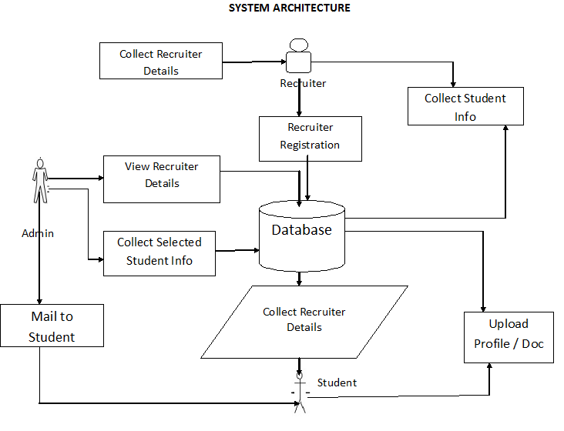
SYSTEM ARCHITECTURE

Slide 8
PROJECT MODULES:
There are mainly 3 modules in the project “Training and Placement Cell“
They are:
Student module.
Administrator module.
Recruiter module.

Slide 9
STUDENT MODULE CONSISTS OF SERVICES LIKE:
Update details: This service provides the user to update their details.
Check details: This service provides the user to check his details.
Material: This service provides the user to check for materials uploaded by administrator
Mailing: This service provides the user to mail to administrator.
Change password: This service enables the users to change password

Slide 10
ADMINISTRATOR MODULE CONSISTS OF SERVICES LIKE:
Update details: Allows administrator to update his (college) details.
Update statistics: Allows administrator to insert/update statistics like no. Of students selected etc.
Add student: Allows administrator to add a student to database.
Add recruiter: Allows administrator to add a recruiter to database.
Add event: Allows administrator to add/insert an event.
Approve: Allows administrator to verify the details of the student, and to Approve him to the application if they are correct.
Student details: Allows administrator to search for student information According to eligibility criteria for recruitment process.
Upload material: Allows administrator to upload material for students.
Mailing: Allows administrator to reply for the mails sent by users.
Change password: This service enables the administrator to change password.

Slide 11

RECRUITER MODULE CONSISTS OF SERVICES LIKE:
Update details: This service provides the user to update their details.

Slide 12
REQUIREMENT ANALYSIS
HARDWARE REQUIREMENTS
Processor : Pentium –I Core
RAM : 2 GB
Hard Disk : 1.28GB
SOFTWARE REQUIREMENTS
Operating System : Windows 7/8/10
Front End : HTML, CSS AND BOOTSRAP
Script : JavaScript
Back End : PHP
Database : MYSQL
Cloud Service : Amazon Web Service

Slide 13
REFERENCES:
Roger S Pressman, “Software Engineering – A Practitioner’s approach” McGraw – Hill International Editions, Fifth Edition, 2001.
Henry F Korth, S. Sudharshan, “Database System Concepts” McGraw – Hill International Editions, Fourth Edition, 2002.
George Koch, Kevin Loney, “Oracle – The Complete Reference”, Tata McGraw Hill, Third Edition, 2001.
James Jawroski, “Mastering Java Script”, Tmh 3/e, 2000.
D.J. Abadi, “Data Management: Limitations and Opportunities,” IEEE Data Eng. Bull vol. 32, no. 1, pp. 3-12, Mar. 2009.
“Microsoft SQL Server”, Solomon, Rankins -SamsPublications, Second Edition.

Slide 14
THANK YOU

